Slide 1
Principles of Software Testing
SQA: Manual & Automated Testing

Slide 2
Background
Software testing is a crucial part of the software development process, making sure that products are robust, functional, and up to users' needs and desires.
But still, testing is more than simply verifying whether "everything works", it requires performing it efficiently and effectively
It is important that you achieve optimum test results while conducting software testing without deviating from the goal
But how you determine that you are following the right strategy for testing?
For that, you need to stick to some basic testing principles.
There are the common seven testing principles that are widely practiced in the software industry.

Slide 3
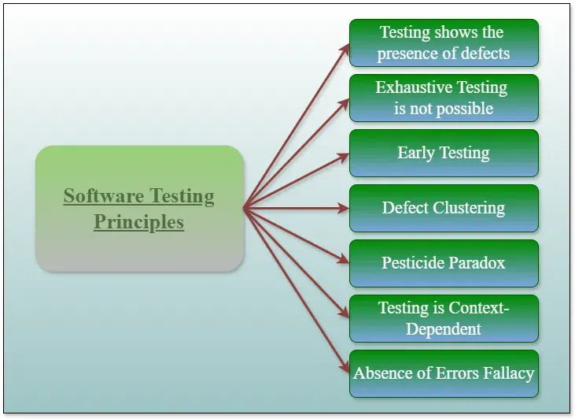
Software Testing Principles: At a glance
Notes:
🧪 Software Testing Principles (Short & Simple)
1️⃣ Testing shows presence of defects
👉 Testing can find bugs, but can’t prove no bugs exist
📌 Example: App works fine in testing → still may fail in real use
2️⃣ Exhaustive testing is not possible
👉 You can’t test everything
📌 Example: Infinite input combinations → test only important ones
3️⃣ Early Testing
👉 Start testing early to reduce cost
📌 Example: Catch requirement mistakes before coding
4️⃣ Defect Clustering
👉 Most bugs are found in a few areas
📌 Example: Login module has most issues
5️⃣ Pesticide Paradox
👉 Same tests stop finding new bugs over time
📌 Example: Update test cases regularly
6️⃣ Testing is Context-Dependent
👉 Testing approach depends on project type
📌 Example: Banking app vs game testing is different
7️⃣ Absence of Errors Fallacy
👉 No bugs ≠ Good product
📌 Example: Bug-free app but doesn’t meet user needs
📌 One-line Summary
👉 Testing finds bugs, not perfection — test smart, early, and adapt

Slide 4
Principle 1: Testing shows the presence of defects
Testing can prove the presence of defects.
Deviations discovered while testing show a failure.
The cause of the failure might not be obvious.
Testing reduces the probability of defects remaining undiscovered.
The absence of failure does not prove the correctness of the software.
The test procedure itself might contain error
The test conditions might be unsuitable for finding errors.

Slide 5
Principle 2: Exhaustive testing is not possible
Exhaustive testing: A test approach in which the test suite comprises all combinations of input values and preconditions
Test case explosion: Defines the exponential increase of efforts and costs when testing exhaustively
Sample test: The test includes only a (systematically or randomly derived) subset of all possible input values
Under real life conditions, sample tests are generally used.
Testing all combination of inputs and preconditions is only economically feasible in trivial case

Slide 6
Principle 3: Early testing
The earlier a defect is discovered, the less costly is its correction.
Highest cost effectiveness when errors are corrected before implementation
Concepts and specifications may already be tested.
Defects discovered at the conception phase are corrected with the least effort & costs.
Preparing a test is time consuming as well.
Testing involves more than just test execution.
Test activities can be prepared before software development is completed.
Testing activities (including reviews) should run in parallel to software specification and design.

Slide 7
Principle 4: Defect clustering
Find a defect and you will find more defects nearby!
Defects often appear clustered like mushrooms or cockroaches
It is worth screening the same module where one defect was found
Testers must be flexible
Once a defect is found it is a good idea to reconsider the direction of further testing.
The location of a defect might be screened at higher detail level, e.g. starting additional tests or modifying existing tests.

Slide 8
Principle 5: Pesticide paradox
Repeating tests under the same conditions is ineffective.
  Each test case should contain a unique combination of input parameters
  For a signal test objects, otherwise no additional information can be gained.
  If the same tests are repeated over and over again, no new bugs can be found
Tests must be revised regularly for different code modules.
  It is necessary to repeat a test after changes have been made in the code (bug fixing, new functionality).
  Automating tests can be an advantage if a group of tests cases is used regularly.

Slide 9
Principle 6: Testing is context dependent
Testing is done differently in different contexts
Different test objects are tested differently.
The engine controller of a car requires tests different than those of an ecommerce application
Test environmental (test bed) vs. production environment
Test take place on an environment other than the production environment.
The test environment should be very similar to the production environment.
There will always be deviations between test environment and the production environment. These deviations impeach the conclusions drawn after testing.

Slide 10
Principle 7: Absence of errors fallacy
Successful testing find the most serious failure
In most cases, testing will find all defects of the system (see principle 2), but the most serious defects should be found.
This alone does not prove the quality of the software.
The functionality of the software may not meet the needs and expectations of the users.
You can not test quality into the product, it must be built in from the very beginning!

Slide 11
Summary:
Tests can help finding defects in the software, however; they can not give proof of the absence of defects
For non-trivial system, exhaustive testing is impossible, sample testing necessary.
Early testing helps reduce costs because defects discovered early on are fixed with less effort
Defects show up clustered. Finding a defect at one place will mean you probably find another defect nearby.
Repeating identical tests produces no new information
Each particular environmental determines the way in which tests will run
Error-free software does not imply suitability for use.

Slide 12
Human Psychology and Testing
The software that we work on applies a humanistic approach that necessitates human participation at every level.
And the software is always created, tested, and also most of the time, used and misused by humans.
Therefore, it takes a great deal of work and understanding to be ready to accept the reality of our human error.
Thus, several psychological elements affect productivity and testing.

Slide 13
Different mindset with Example
We work constructively toward the software during development with the goal of satisfying client needs. On the other hand, we search for flaws in the product when we test or examine it.
Example: Imagine working as a chef in a five-star establishment. Using the ingredients at hand, it is your responsibility to prepare the greatest meal you can. From your perspective, the meal is perfect because you bring all of your expertise to the table. Imagine now that the hotel has employed an internal quality inspector to sample your food and report back to the hotel management on its flavor and quality.
The mindset of a quality inspector can be related with that of a tester, and the mindset of a chef with that of a developer. While the chef prepares the cuisine with good intentions, the quality inspector checks the dish for errors or defects.

Slide 14
Characteristics of a Software Tester
Software testing and software development are concurrent processes. Both seek to fulfill predetermined criteria and objectives to meet client’s expectations
But there are difference towards working procedure.
Software development is a creative or constructive act. Software testing, on the other hand, typically falls under the negative or destructive work category.
Furthermore, software testing has developed methods and approaches that are intended to maximize a tester's ability to identify flaws.

Slide 15
Skills in addition to technical skills
Interpersonal skills: First and foremost, testers and developers should communicate clearly, completely, humbly, and comfortably regarding flaws, failures, test outcomes, test progress, risks, etc.
Sharp observation: An "eye for detail" is the second requirement for software testers. If the testers pay close attention, they can easily spot or notice a lot of critical problems.
Destructive creativity: The tester must also acquire destructive talents. The tester should not "hesitate to do negative testing". Checking the system in unexpected circumstances is known as negative testing. Example: If a login ID is designed to only contain letters, for example, the tester should also test it with numbers and special characters.
Customer-oriented perspective: The QAs/Testers should be able to test the product as an end-user and put themselves in the shoes of the consumer.

Slide 16
Ironical but friendly: The tester needs to be determined in challenging even the smallest ambiguity until it is proven, regardless of the project's nature. During the test, various scenarios could occur. This relationship needs to be balanced by the tester. Errors shouldn't be made in the process. The goal of "attacking software issues but not software developers" should be defended and persuaded by testers.
Organized, flexible, and patient at work: Testers should realize that they can also make mistakes. They should therefore be very good at organizing; they also need to have checklists, data, and statistics to back up their conclusions. The tester should also be adaptable and receptive to new procedures. The software should be retested for as many potential new faults as the tester is patient enough to do. In projects where requirements change frequently, testers need to be patient and stay organized.
Objective and neutral attitude: In a software project, testers are like bad news bearers. When the tester is accused of performing his job (i.e., identifying faults) too well, he must be able to handle the situation. The development team should recognize the tester's efforts and accept the mistakes. Because every possible issue the tester may find would result in a smaller chance of a issue the client could have found.
Customer-oriented perspective: The QAs/Testers should be able to test the product as an end-user and put themselves in the shoes of the consumer.

Slide 17
How to improve communication
Effective communication is one of the major competencies of a tester, in addition to technical and the domain knowledge. Moreover, they must to be able to establish a pleasant relationship with their coworkers, particularly with their development team.
  Do not boast - You're not perfect either!
  Do not blame - the errors are probably from the group instead of an individual.
  Be constructively critical and discuss the defect and steps to reproduce it.
Discuss how to fix the defect so that the delivered system is better for the client.
  Do not just see the pessimistic side, praise the efforts as well.
  Show discovered risks and the benefits of fixing the defects.
  Confirm that the developer has understood the defect clearly
Collaborate instead of battling around. Everyone in the project has a common objective of creating better software.
  Be collaborative, kind, and helpful to your colleagues
  Try to understand how the other person feels and why he/she reacts the way they do.

Slide 18
Roles and responsibilities
Developer’s Role | Tester’s Role
Implements requirements | Plans testing activities
Developers structures | Design test case
Design and programs the software | Is concerned only with finding defects
Creating a product is his success | Finding errors made by a developer is the success
Ensures that the final product is closely aligned with customer expectations | Ensures that newly written code has less bugs before it goes into production/live/deployment
Generally comprises unit tests. | Generally comprises multiple tests – regression tests, accessibility tests, usability tests, performance tests, stress tests, etc.

Slide 19

Any Questions?
Thank you!

